Slide 1
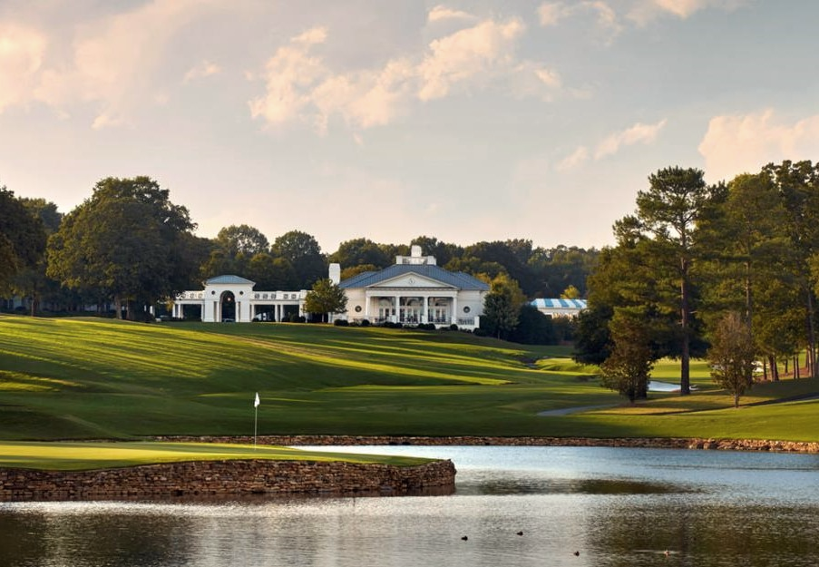
3700 GLENEAGLES ROAD CHARLOTTE, NC 28210 704-542-1553 WWW.QUAILHOLLOWCLUB.COM
QUAIL HOLLOW CLUB
2020 Student Internship Program

Slide 2
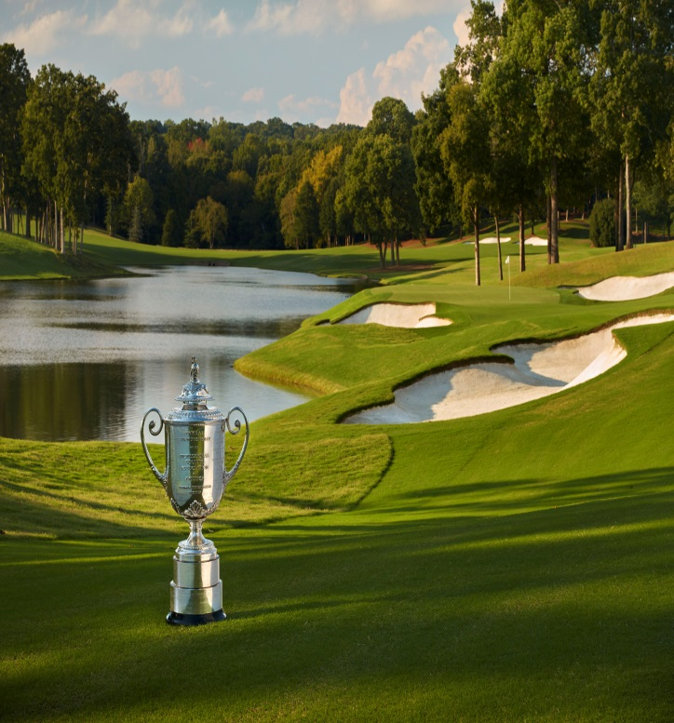
QUAIL HOLLOW CLUB
Student Internship Overview
The internship at Quail Hollow Club is extensive and well rounded.
Interns will receive hands on experience on all aspects of
golf course maintenance and championship preparation.
Everything from equipment operation to overseed transition
will be covered. Students will also be given
leadership opportunities and will understand the full extent of our
maintenance operation upon completion.
Our interns will be given the opportunity to train with veteran staff members who have succeeded at the highest level. We actively seek student interns worthy of the challenges inherent to a golf organization of this caliber. Our interns must possess a strong work ethic, high character, and an enthusiastic positive attitude.
A significant portion of this internship program will include accurate pesticide calibration and application, proper watering techniques, and golf course setup. Our turf grass program is designed to teach you the fundamentals required to be successful in the golf course industry.
You will be trained in the day to day operations of the golf maintenance team and participate in developing the short term and long-term goals for our department.
Our interns also get the opportunity to network and be a part of another tournament set up team as a paid volunteer for one of our peer clubs on the PGA Tour.
Professional golf is embedded in the culture of the club and the course has been the host for the Kemper Open Invitational Golf Tournament (1969-1979), the World Seniors Invitational Golf Tournament (1980-1989), the Wells Fargo Championship (2003- Current) and The PGA Championship (2017). A few notable winners in the past have been Jim Furyk (2006), Tiger Woods (2007), Rory Mcllroy (2010, 2015), Rickie Fowler (2012) Justin Thomas (2017) and Jason Day (2018). The club will host the Presidents Cup in 2021 and expects to be broadcast to over 1 billion television sets worldwide.

Slide 3
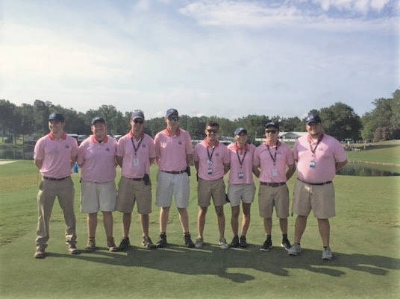
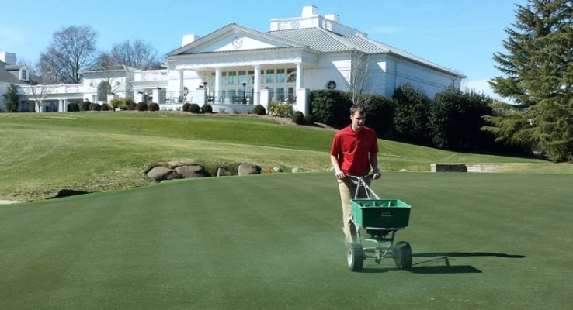
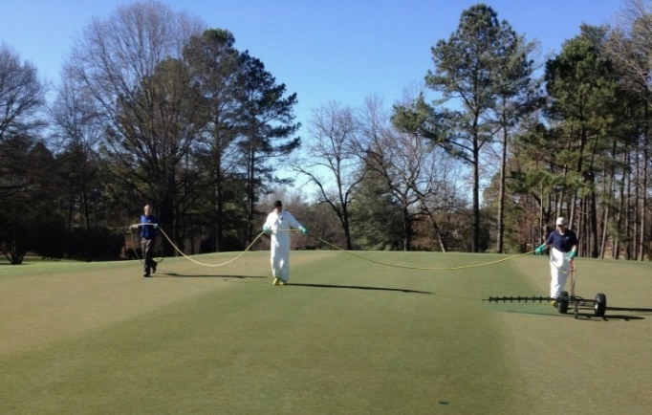
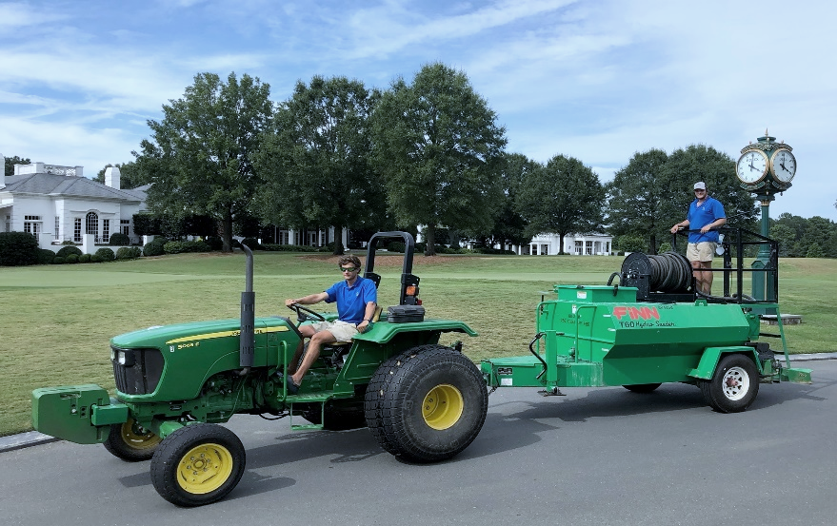
QUAIL HOLLOW CLUB
Turfgrass Intern Job Description
COURSE SUMMARY: Quail Hollow Club is considered by many to be one of the finest courses in the United States. The course was originally designed by famed golf course architect George Cobb in 1961 to capture the beauty as well as challenging terrain of the Piedmont region of North Carolina. In the intervening years, the course has undergone a series of improvements, including modifications to several holes by Arnold Palmer in 1986, and a redesign by Tom Fazio in 1997, 2013, 2016 and 2019.
JOB SUMMARY: The internship is an opportunity for driven,
dependable, hardworking individuals that want to advance their education and
experience through an internship with our organization. The internship
offers exposure to all aspects of golf course maintenance and
championship preparation.
Your internship will cover:
Equipment operation
Experience transitioning from cool season to warm season (late spring)
Overseeding in the Fall
Pesticide calibration and application
Fertility program
Weed identification and eradication
Record keeping
Water management
Course set-up
Irrigation operations + maintenance
SubAir maintenance
Large scale projects
Crew leadership training
Budget management
SALARY: Competitive wages starting at $12.00/hour (plus overtime)
DURATION OF INTERNSHIP: Three, Six and Twelve Month
Internships are available.
BENEFITS: Housing , Meals, Uniforms, Golf Privileges,
Leadership Training, Hands-on Experience, and Paid Volunteer Opportunity.
APPLICATION PROCESS:
Send a resume with a cover letter to austinl@quailhollowclub.com.
CONTACT INFORMATION:
Quail Hollow Club
Attn: Grounds Department
3700 Gleneagles Road
Charlotte, NC 28210
austinl@quailhollowclub.com
704-542-1553 (direct line)

Slide 4
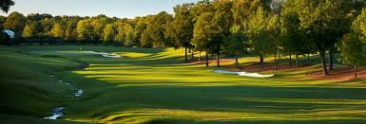
Quail Hollow Club Internship Program
Contact Information:
Director of Green and Grounds: Keith Wood
woodk@quailhollowclub.com
Golf Course Superintendent: Shane Omann
omanns@quailhollowclub.com
Assistant Golf Course Superintendent:
Dylan Farber
farberd@quailhollowclub.com
Parker Henry
henryp@quailhollowclub.com
Mike Stell
stellm@quailhollowclub.com
Agronomy Assistant
Lori Austin
austinl@quailhollowclub.com

